Slide 1
Mu Alpha Theta
“Mew Alpha Theta”
First Meeting
29 November 2016
MAΘ
Notes:
※ was created on Google Slides and may contain discrepancies from the original presentation when converted to PowerPoint

Slide 2
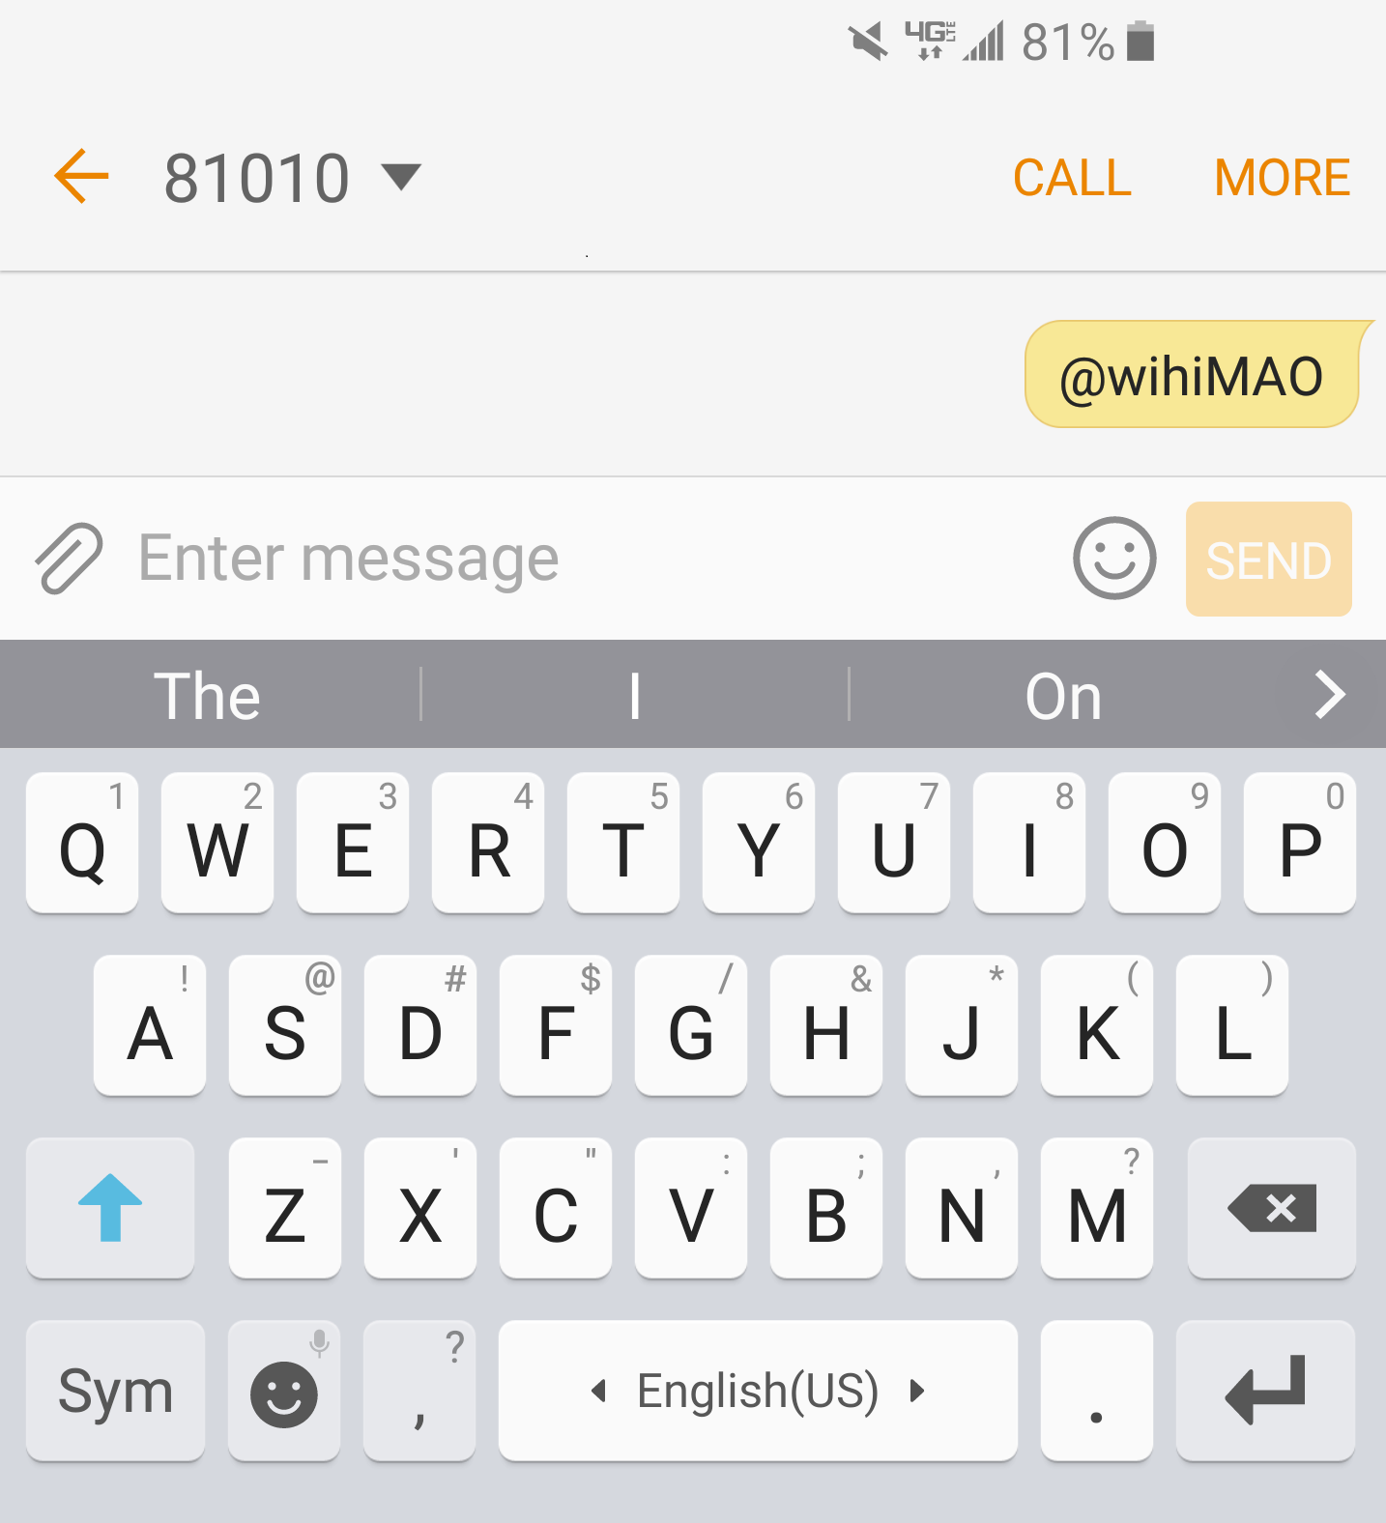
Remind 101
To the number 81010,
Text “@WiHiMAO” (not case-sensitive) ** Standard messaging fees may apply

Slide 3
Website
http://vickerswihimath.weebly.com/ mu-alpha-theta.html
Documents
Next meeting date

Slide 4
Member Responsibilities
Regularly attend meetings
Represent MAΘ as an honorary member
1 hour of service each month
Maintain GPA requirement (3.0 in math, 2.0 overall)
Pay a one-time membership fee ($10.00; due in Jan)

Slide 5
Service
Tutoring
After school
Participating in MAΘ-related activities
Other community-service activities

Slide 6
Concession Stand
December 6th
3:00~6:45 P.M.
Come directly to A-21 instead of going to café
Service Opportunity!

Slide 7
SAT Prep
Another service opportunity!
Review / Training
Details TBD
Remind

Slide 8
Brief Tutoring Review
Mu Alpha Theta

Slide 9
Refer to the other presentation: “Tutoring Review”

